Slide 1
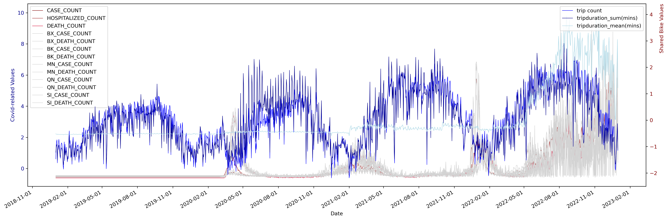
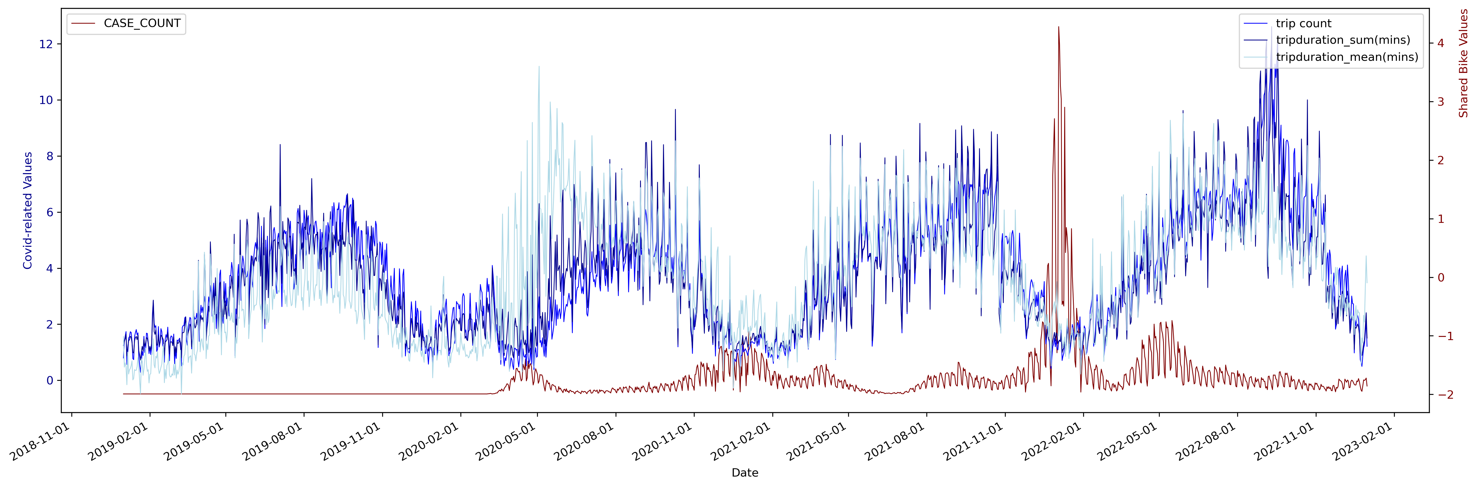
Time series of data related to bike-sharing and COVID in New York City
(a)
Time series of data related to bike-sharing and COVID in Boston
(a)

Slide 2
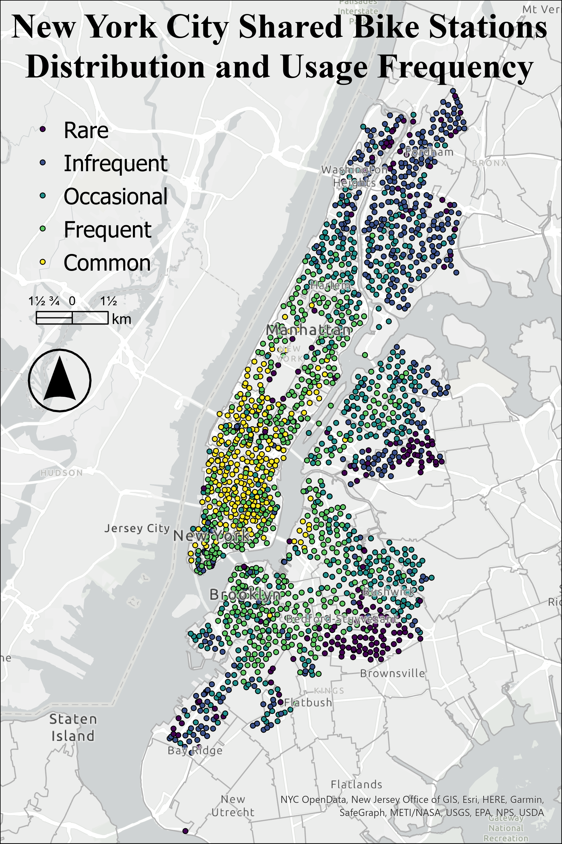
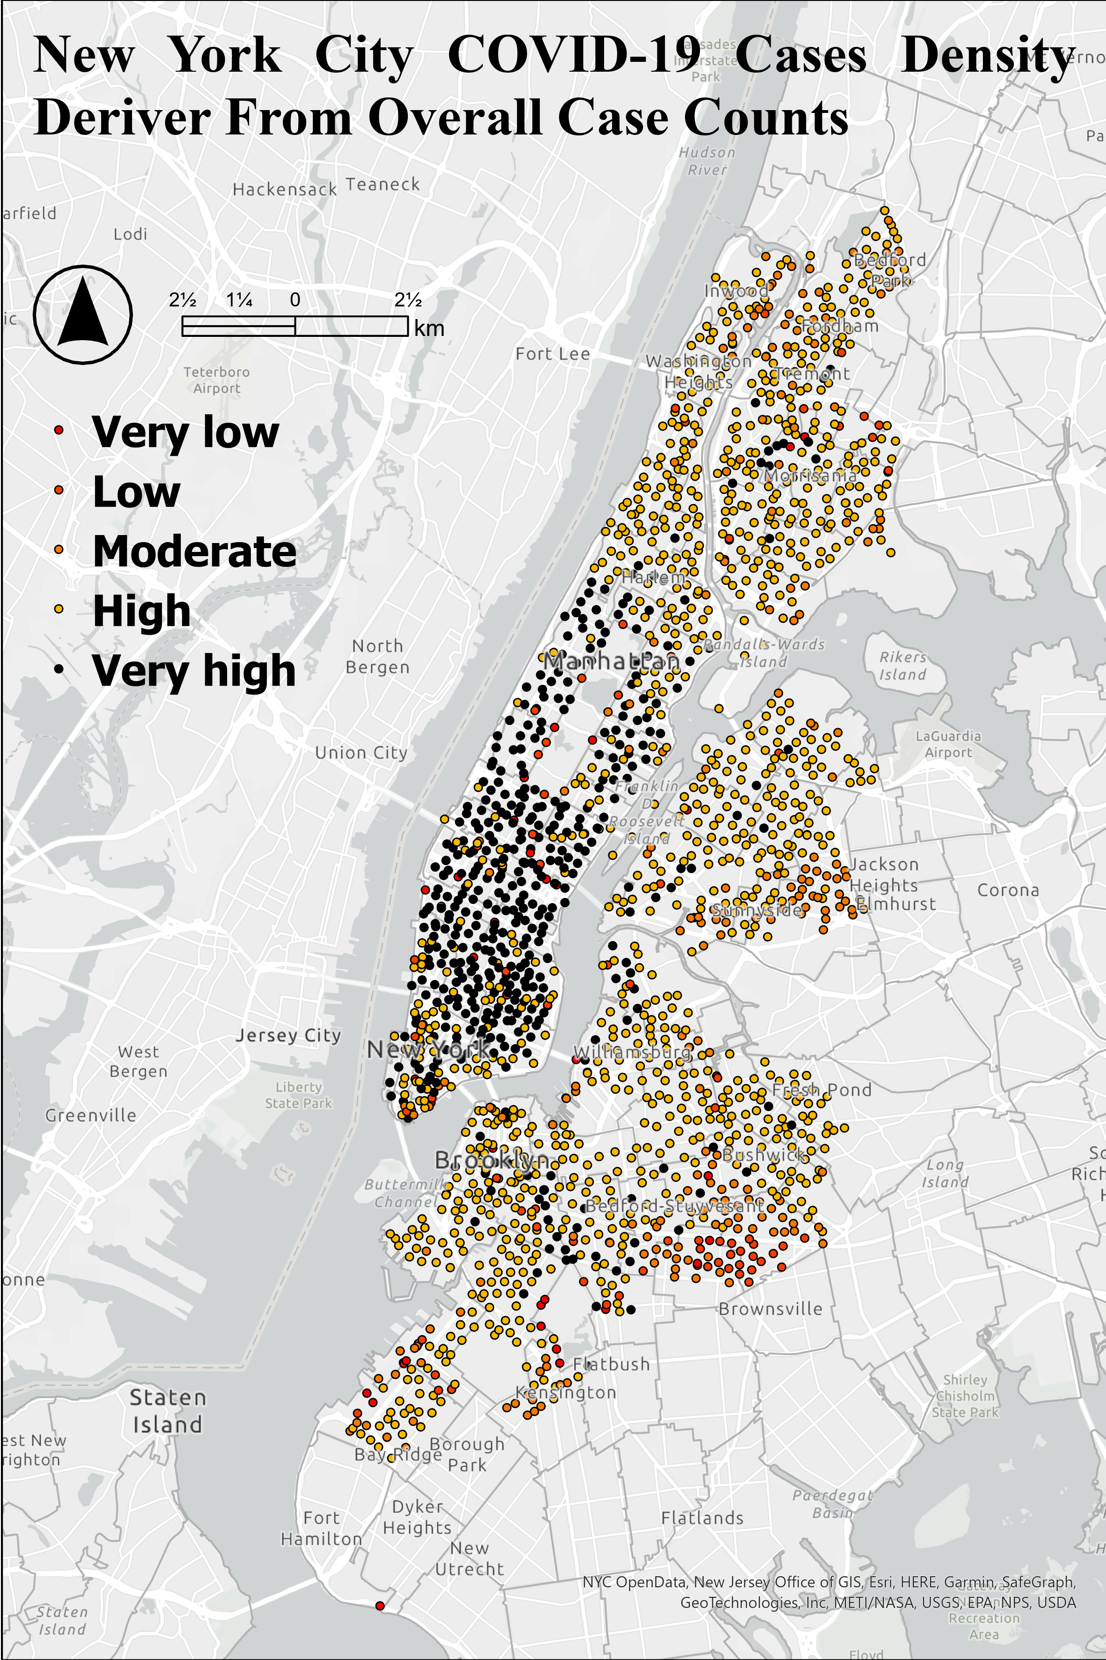
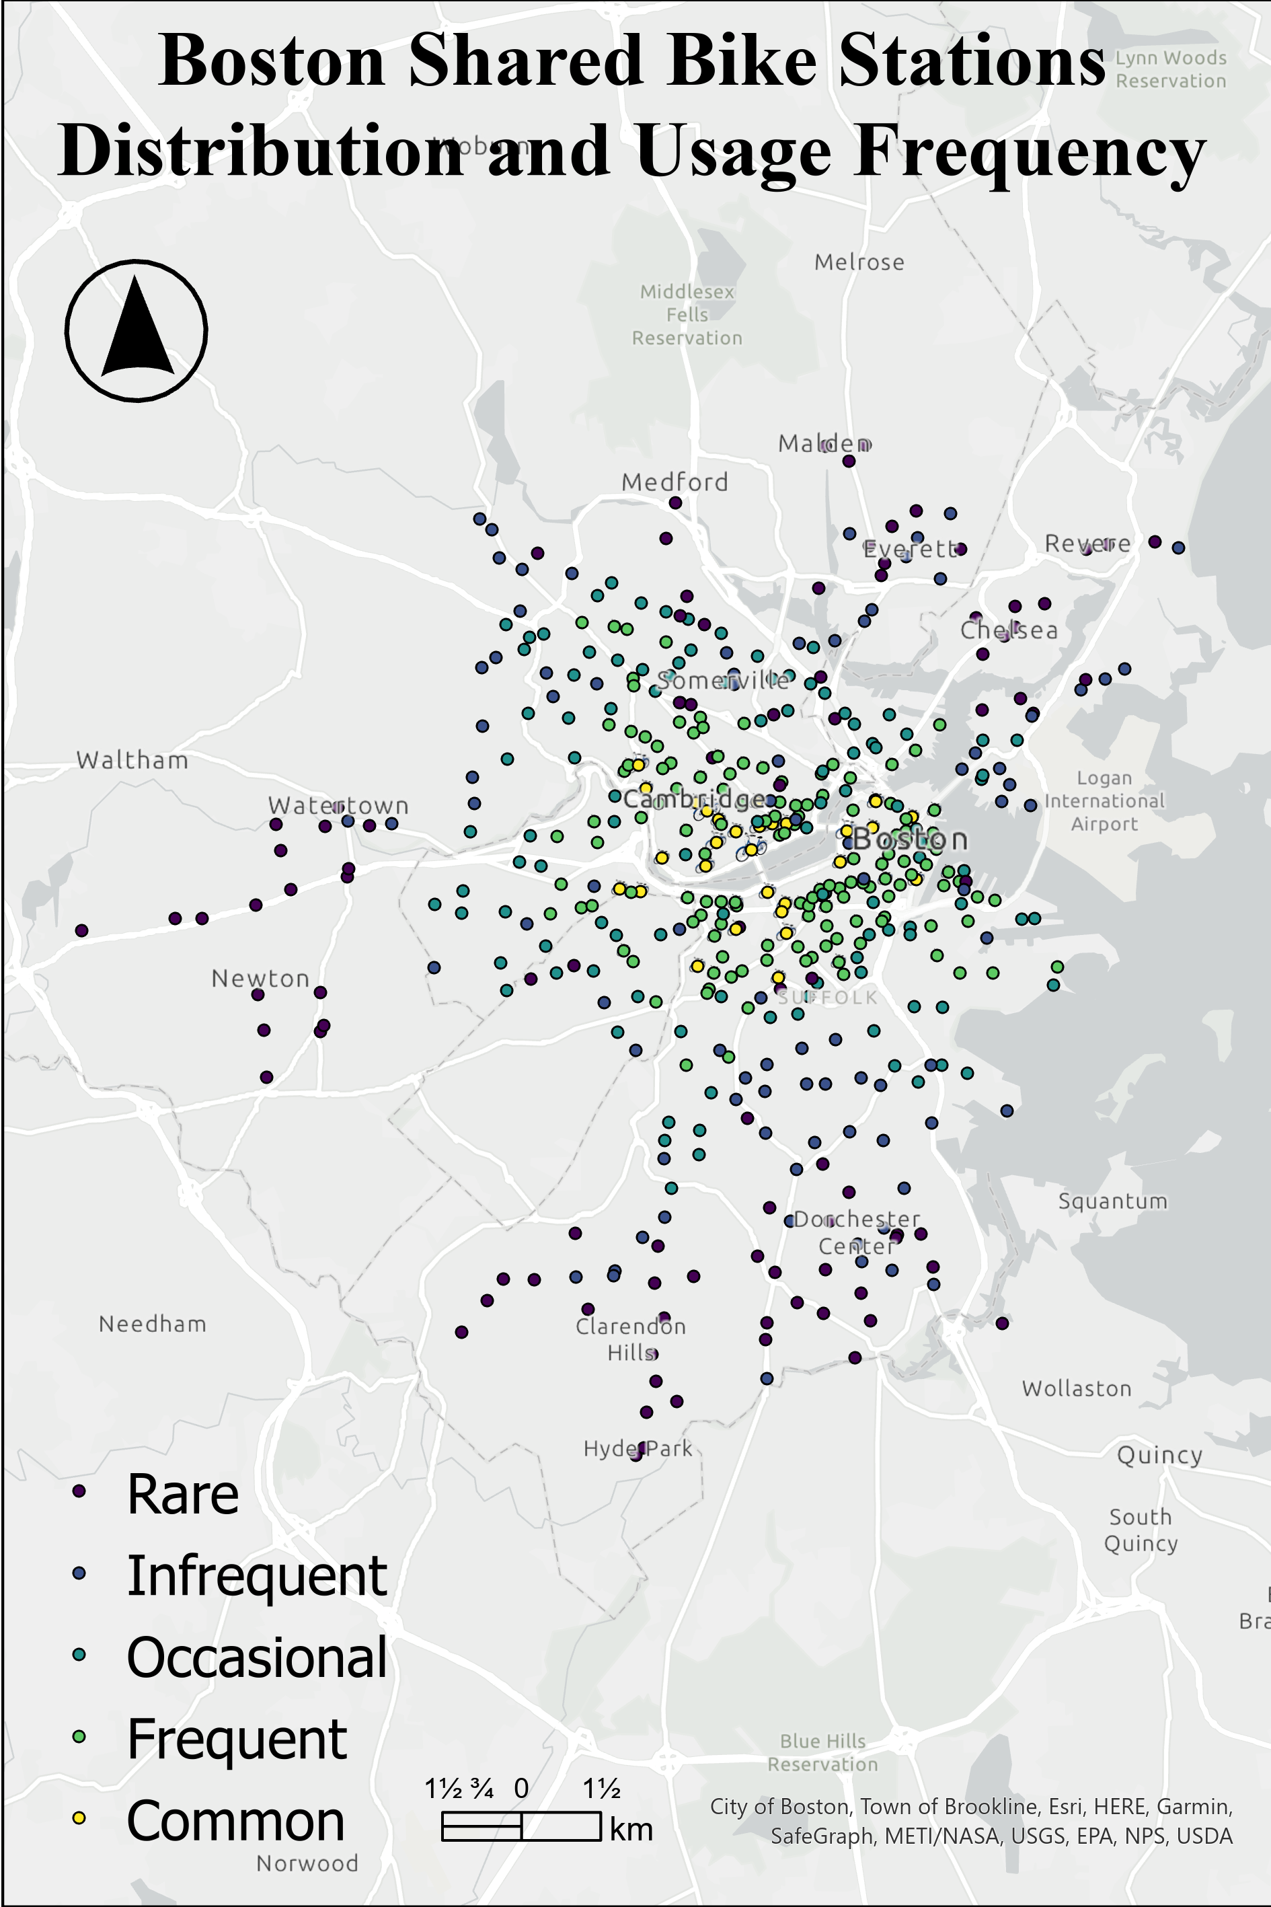
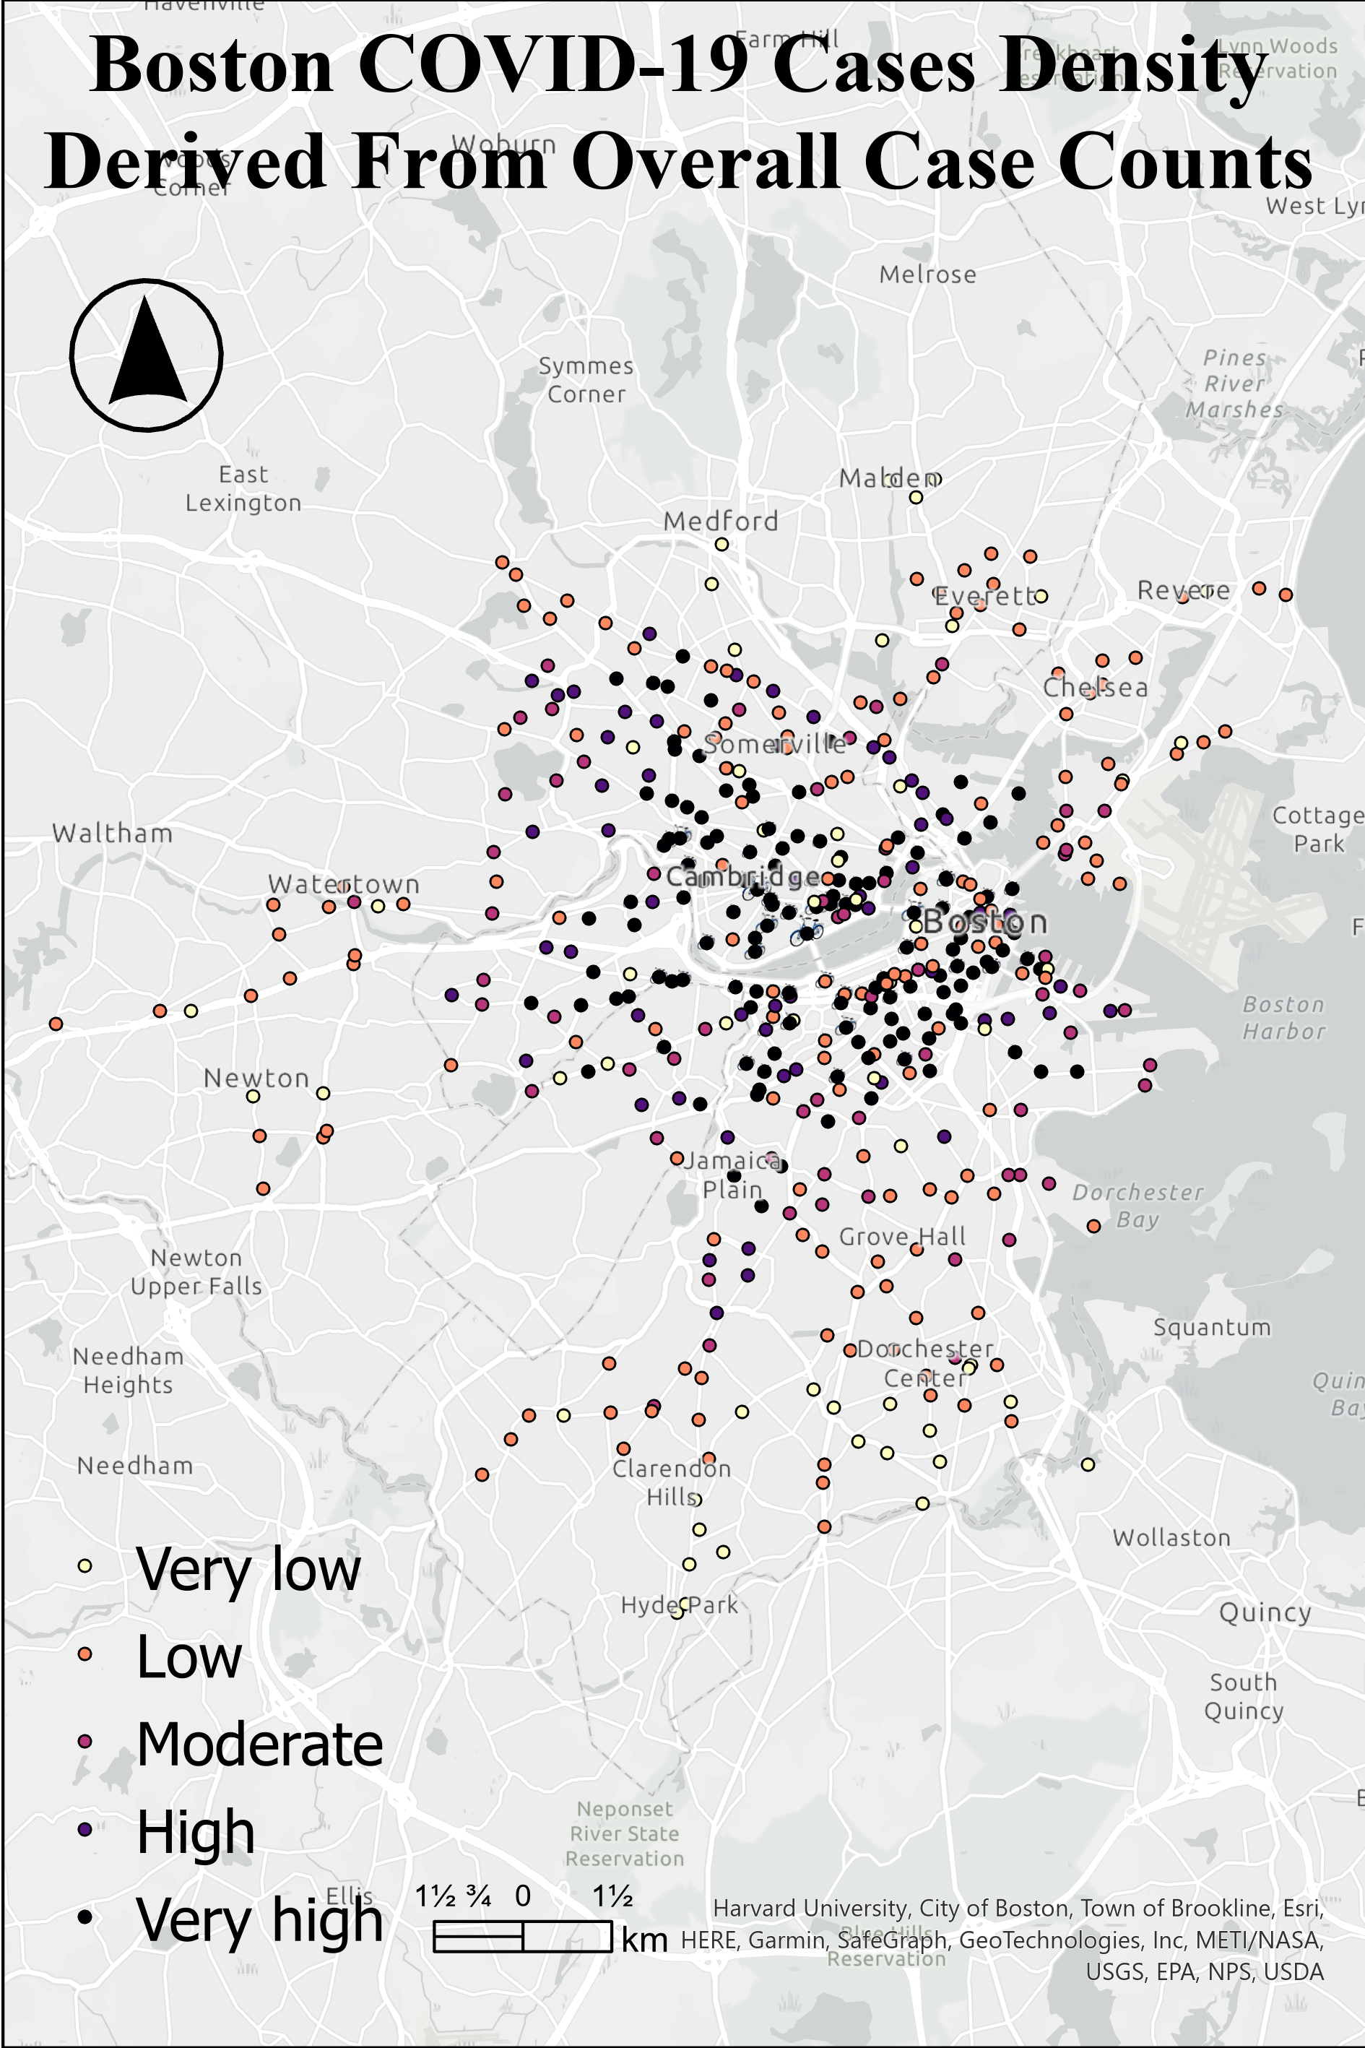
(a)
(b)
(c)
(d)

Slide 3
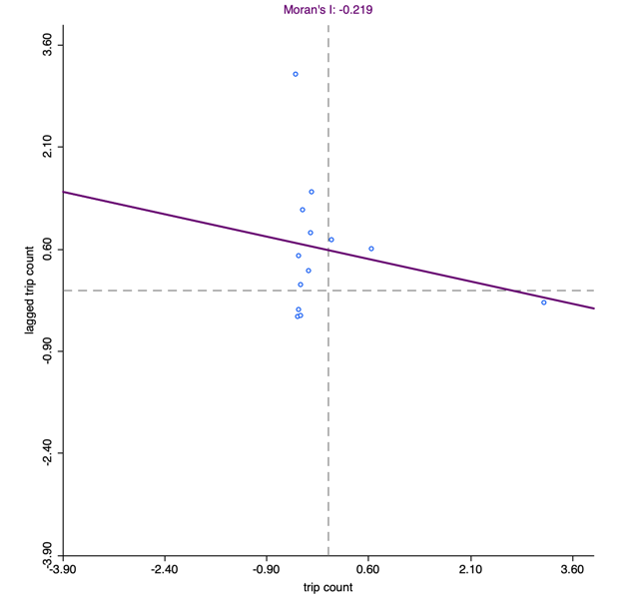
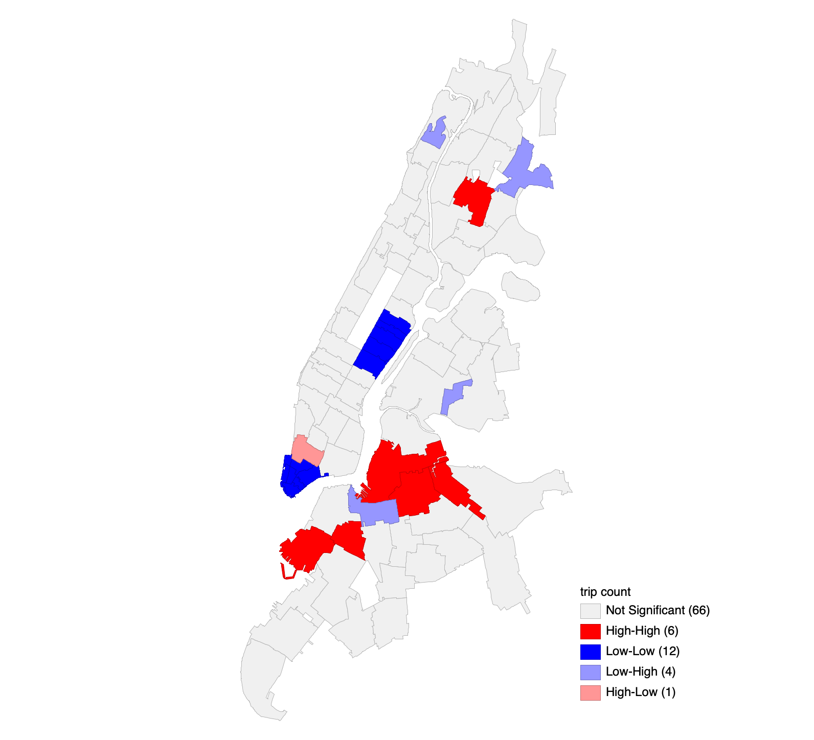
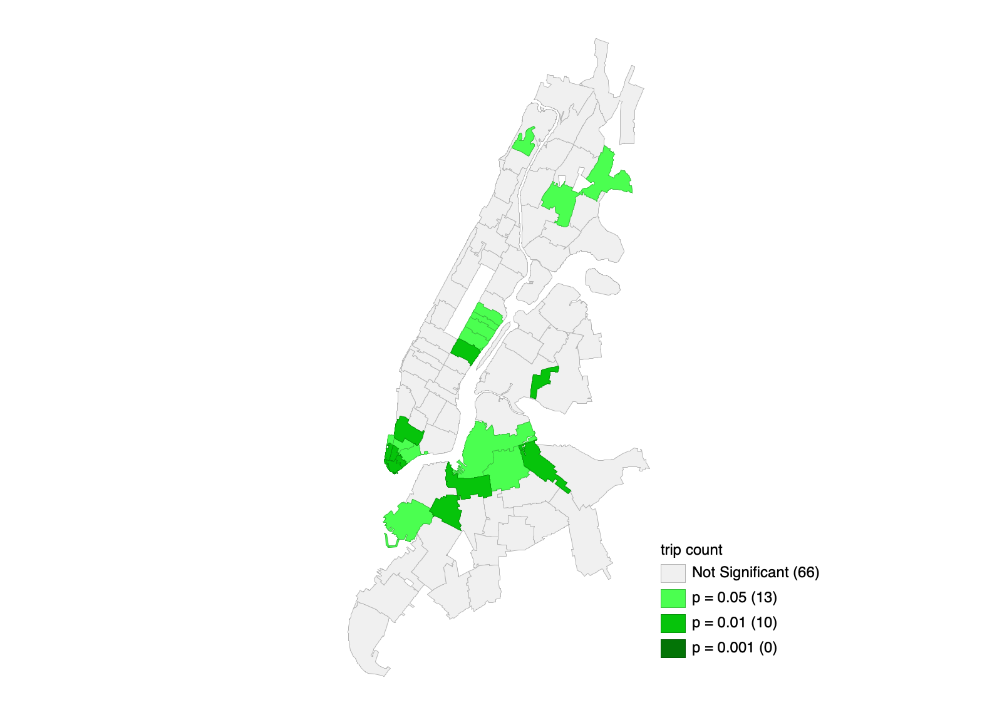

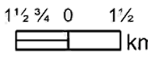
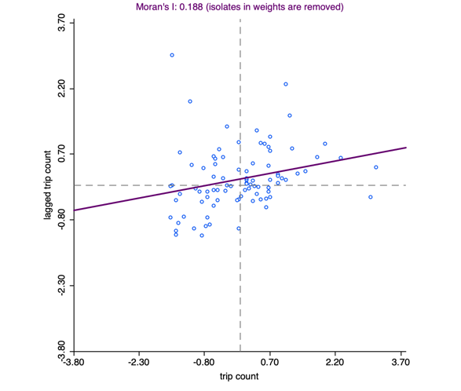
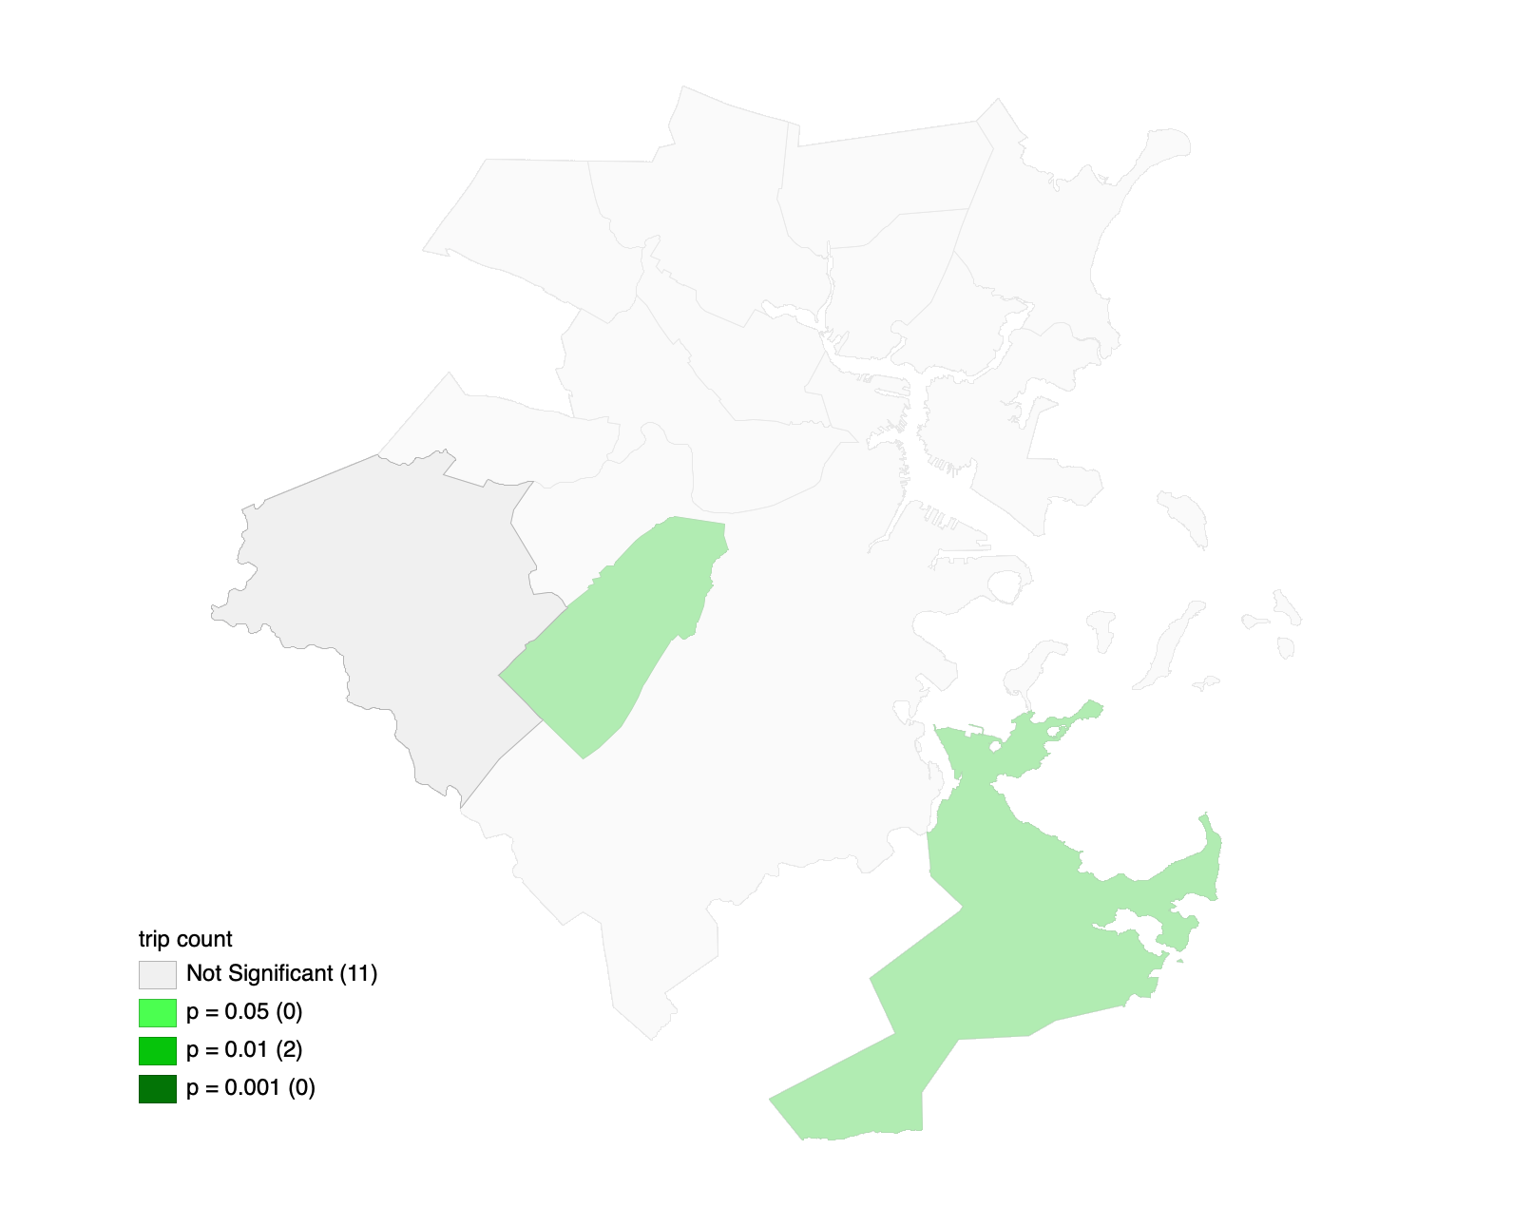
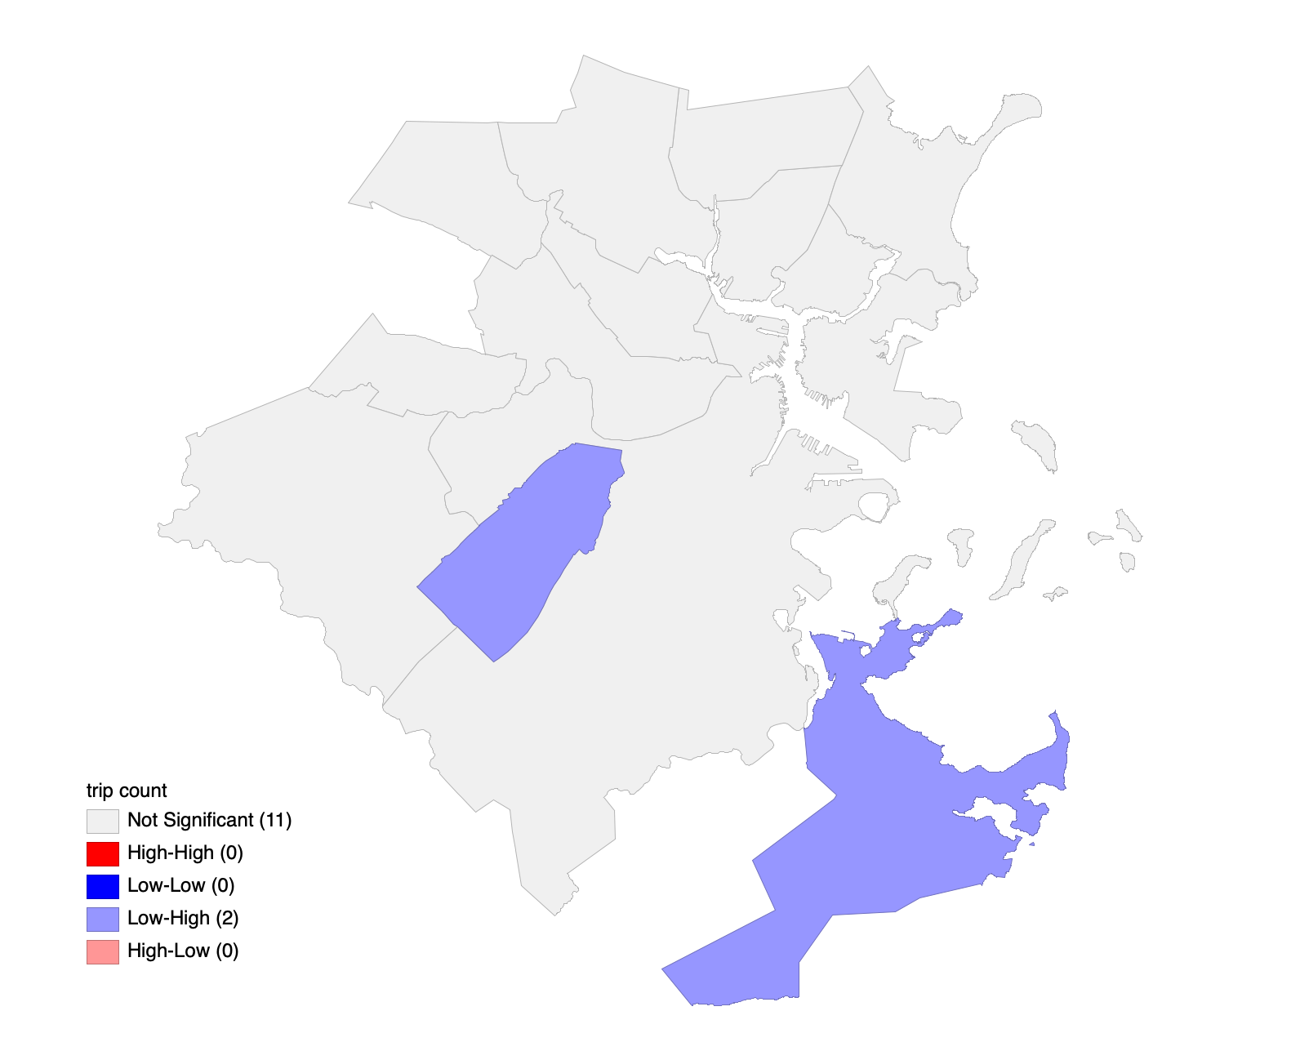
(a)
NYC local Moran’s I
(b)
NYC Universal Moran’s I (-0.219)
LISA Cluster Map
LISA Significance Map
(c)
Boston local Moran’s I
(d)
Boston Universal Moran’s I (0.188)
LISA Significance Map
LISA Cluster Map

Slide 4
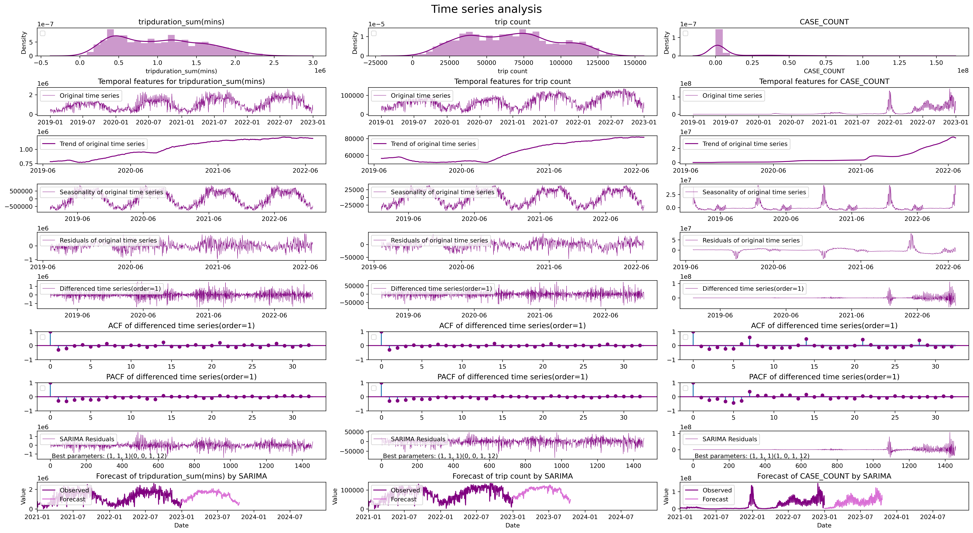
New York City time series analysis
a
b
c
1
2
3
4
5
6
7
8
9
10

Slide 5
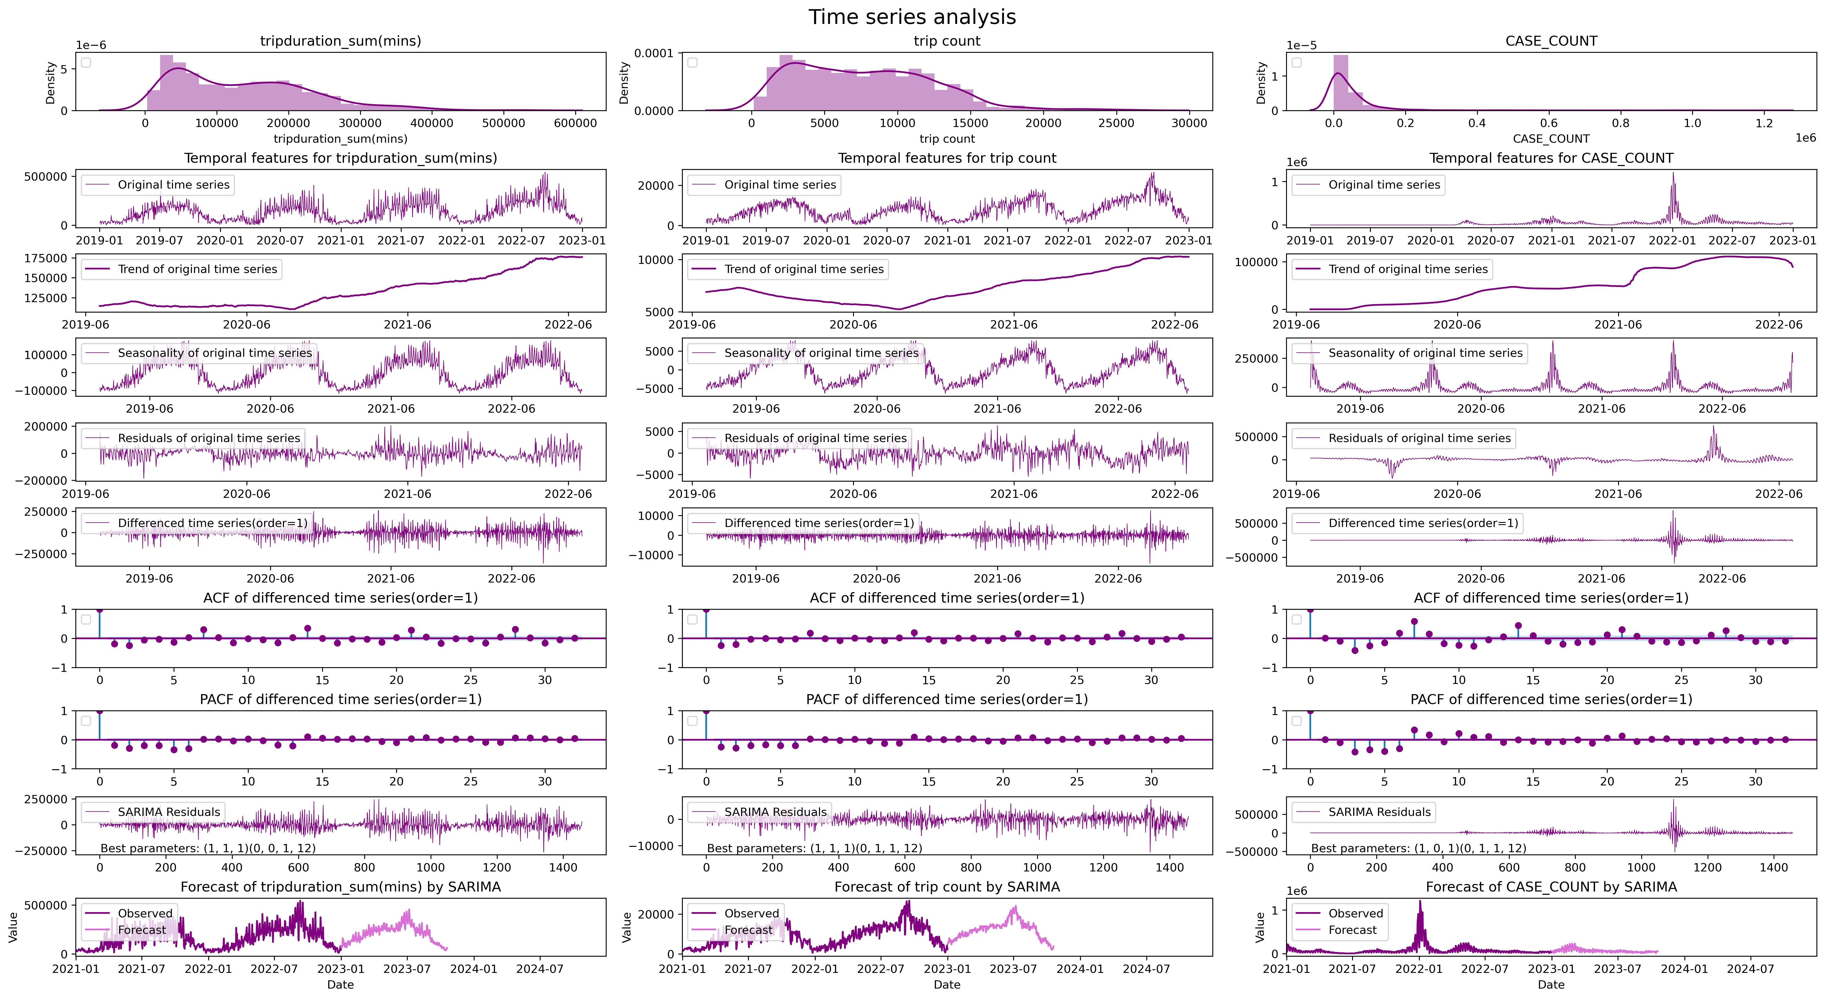
Boston area time series analysis
a
b
c
1
2
3
4
5
6
7
8
9
10

Slide 6
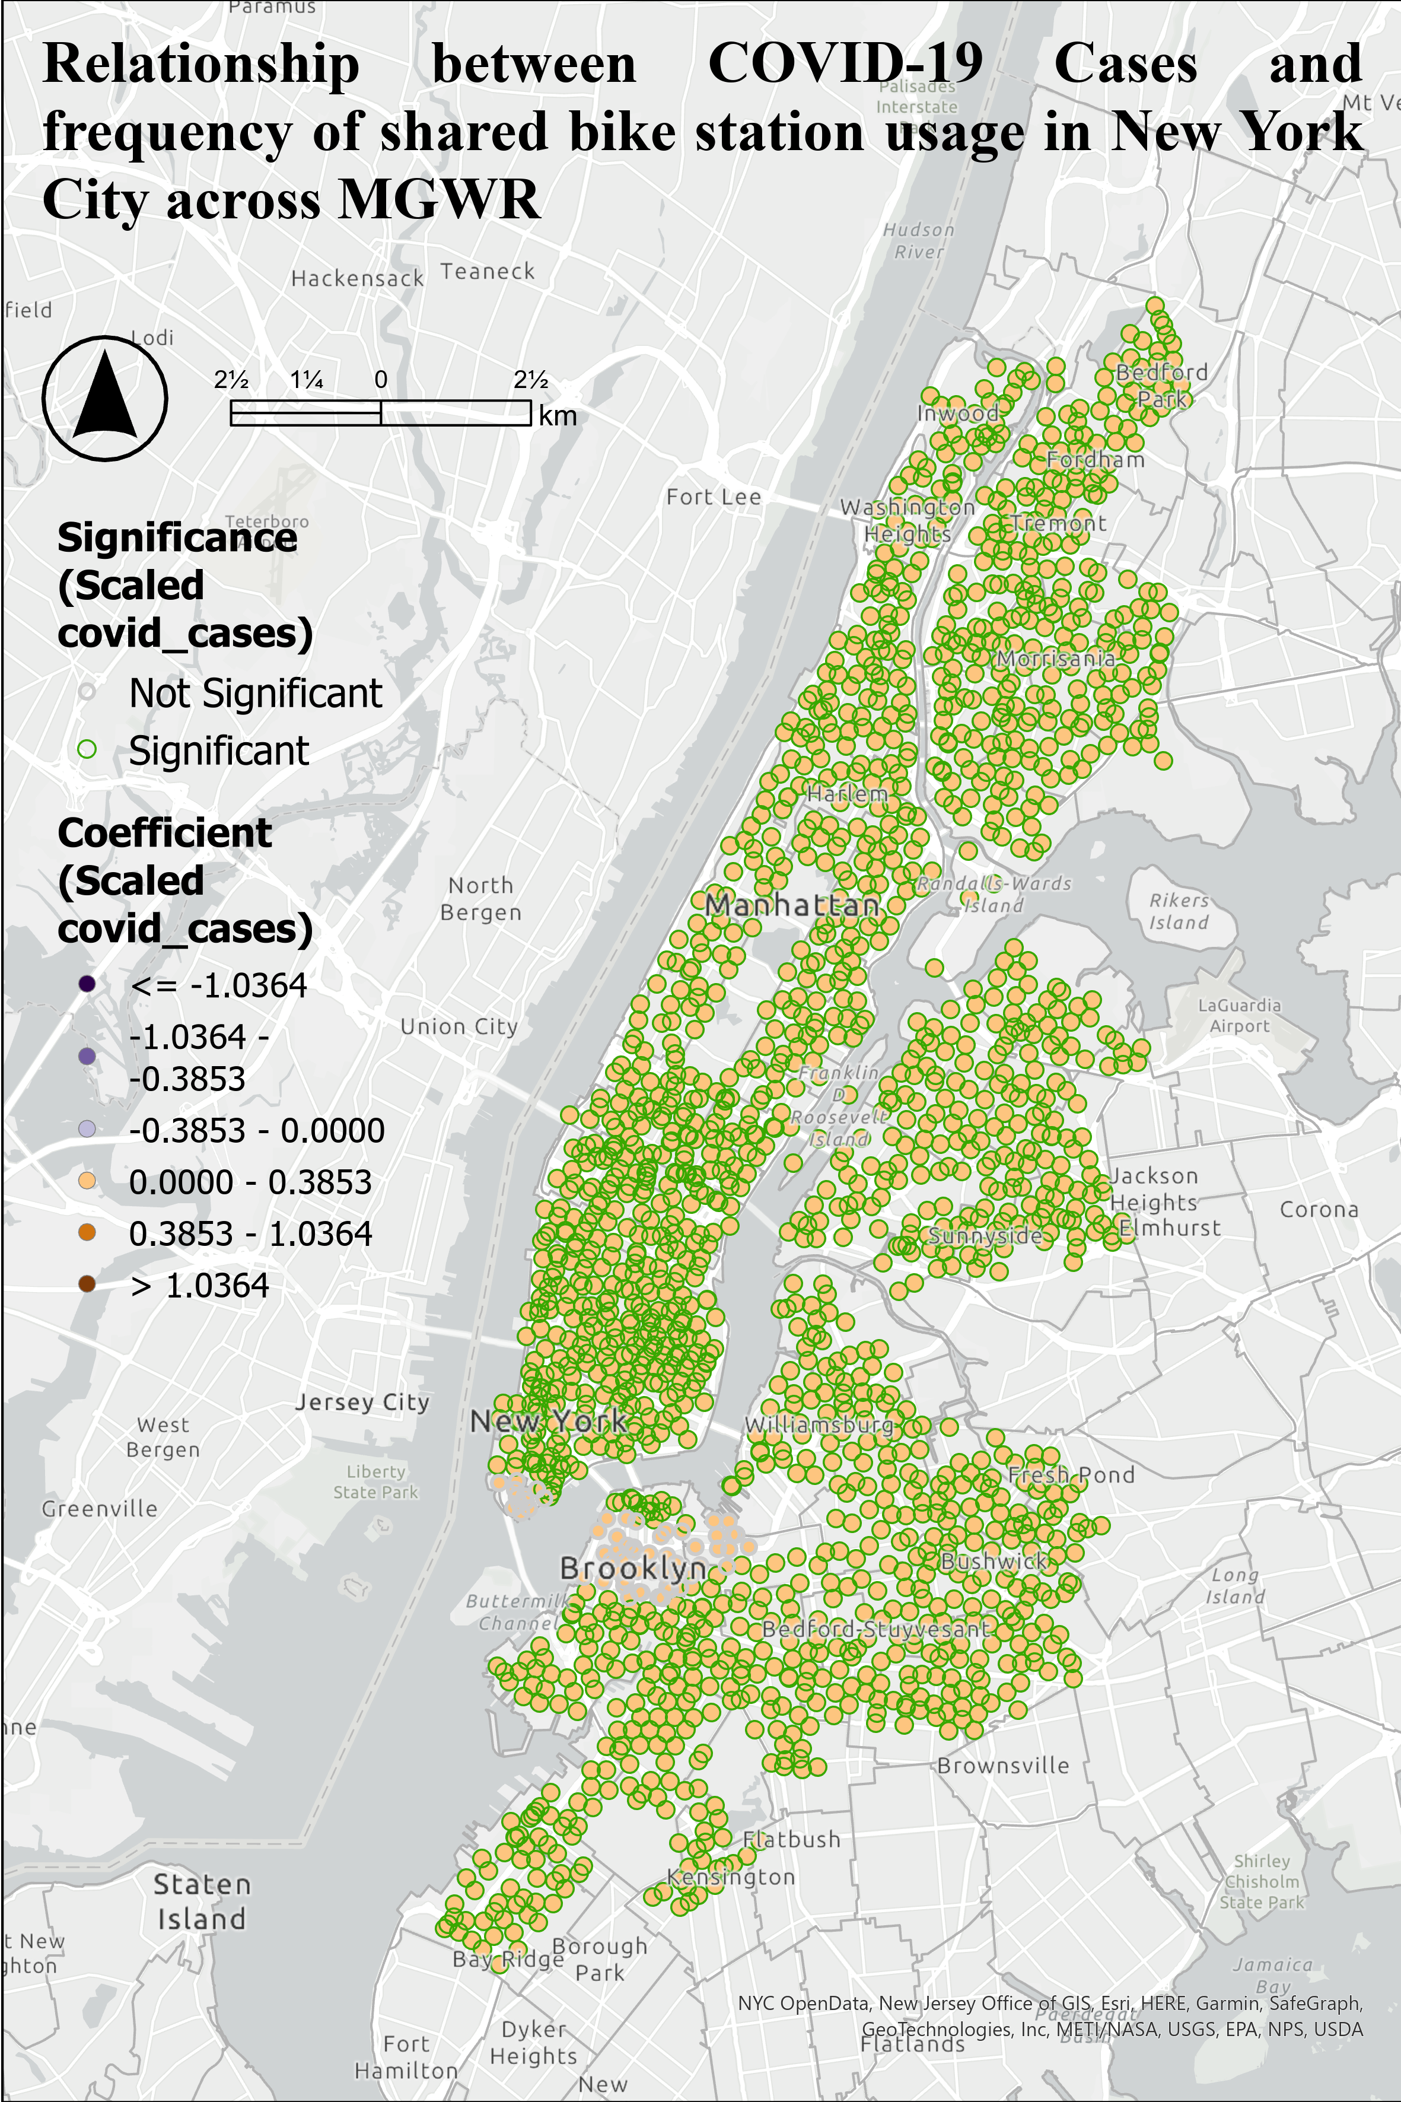
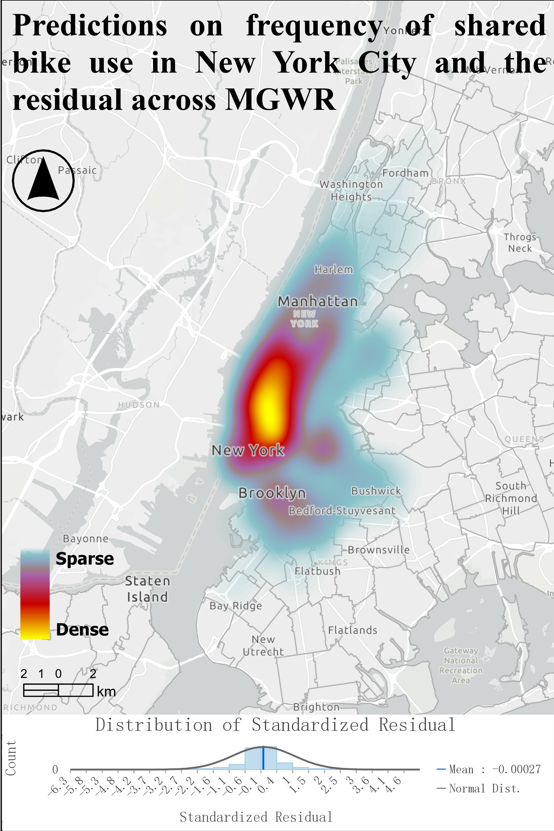
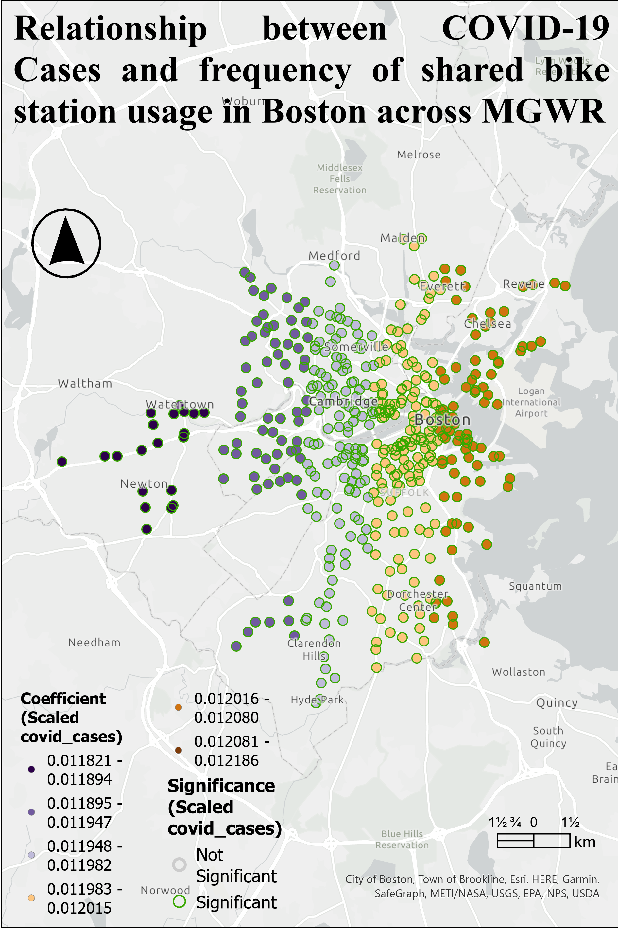
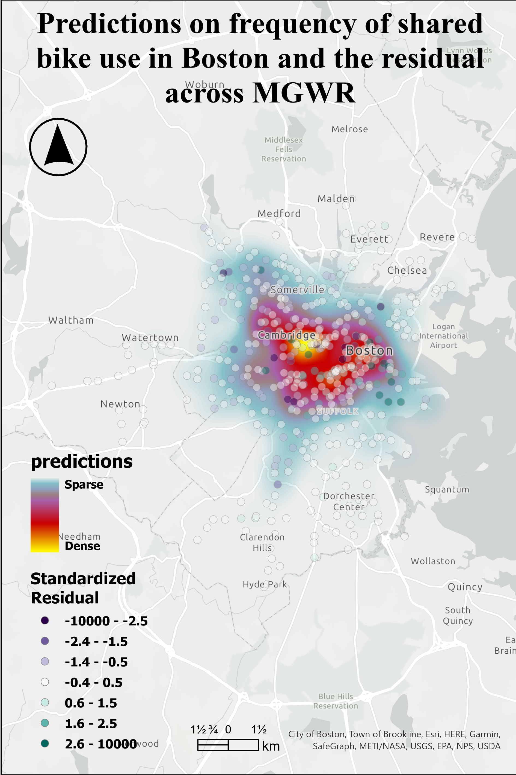
(a)
(b)
(c)
(d)

